Slide 1

Women’s Safety Portal: Real-Time AI Emergency Syste
This innovative system empowers women with real-time AI-driven emergency alerts.

Slide 2

The Alarming Reality of Women’s Safety Today
Global Scale
1 in 3 women face violence or harassment yearly.
Emergency Delays
Average response time is 15 minutes in cities.
Consequences
Delayed help causes physical and psychological harm.
Urgent Need
We must empower with technology bridging danger and aid.

Slide 3
Bridging the Safety Gap with Technology
Instant Alert System
24/7 Access
Live Navigation
Streamlit Platform
AI-driven emergency response activates immediately to Police and Family.
Accessible via mobile and desktop anytime, anywhere.
Connects users directly to first responders in real time.
Chosen for fast development, scalability, and sleek UI.

Slide 4
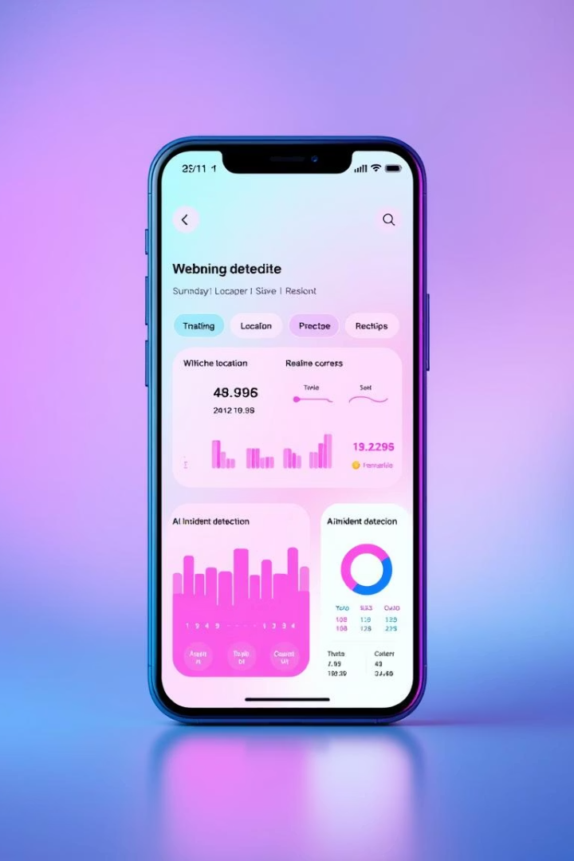
Key Features of the Women’s Safety Portal
Location Sharing
Real-time GPS updates sent to trusted contacts and authorities.
AI Incident Detection
Analyzes text, voice, and video to recognize emergencies.
Automated Alerts
Instant emergency calls and personalized messages sent automatically.
Interactive Dashboard
Tracks safety stats and response progress in real time.

Slide 5
User Experience Designed for Accessibility & Comfort
Modern Design
Intuitive Workflow
Voice Commands
Responsive Layout
Pink/violet gradients with soft, rounded UI elements.
Minimizes steps during emergency situations for quick action.
Hands-free activation via natural voice control.
Optimized for phones, tablets, and desktops seamlessly.

Slide 6

AI-Powered Emergency Recognition & Response with One click
Computer Vision
NLP Detection
Monitors video for suspicious behavior and dangerous scenarios.
Understands distress phrases and urgency levels clearly.
Auto-Escalation
Continuous Learning
Adjusts alerts based on AI confidence and severity.
Models improve with anonymized incident data over time.

Slide 7
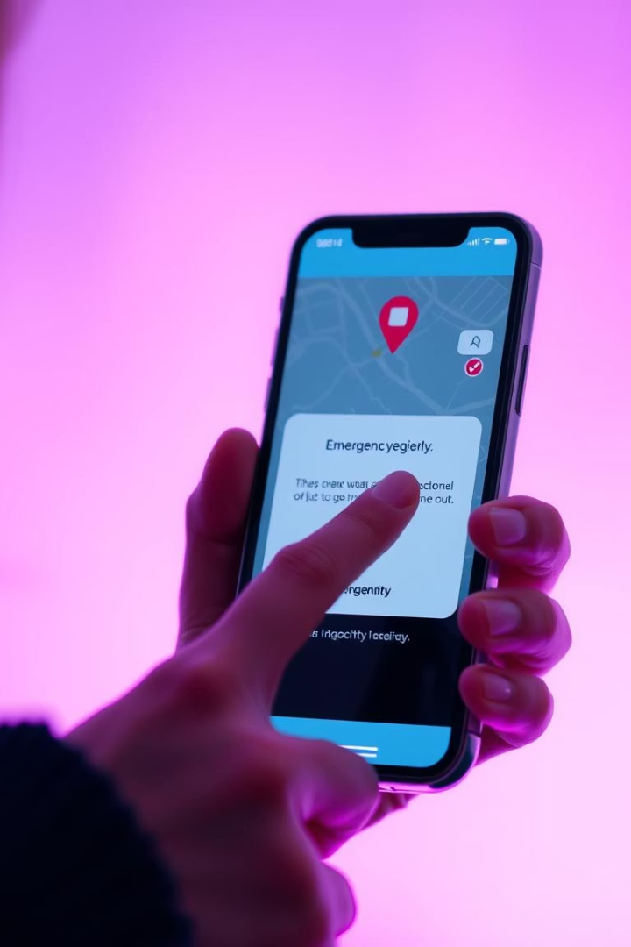




Real-Time Emergency Workflow
Trigger Alert
Activated by user button, voice, or AI detection.
Verify Location
GPS confirms exact position quickly and accurately.
Send Notifications
Emergency services and trusted contacts alerted immediately.
Status Updates
Continuous tracking until incident resolution is confirmed.

Slide 8

Ensuring Data Security & User Privacy
End-to-End Encryption
All communications and location data are fully encrypted.
Compliance
Adheres strictly to GDPR and CCPA regulations.
Anonymous AI Learning
Data aggregated without personal identifiers for safety improvements.
Regular Security Audits
Penetration tests prevent vulnerabilities and breaches.

Slide 9

Impact & Vision for the Future
50%
Millions
Continuous
Response Time Cut
Empowered Users
AI Enhancements
Emergency delays may reduce over half with the portal.
Millions gain proactive safety and peace of mind globally.
Ongoing improvements will increase accuracy and usability.
Future
Expansion Plans
Integrate wearables and build community support networks ahead.

